Slide 1
LIVER

Slide 2
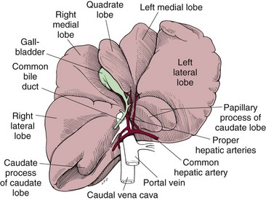

Slide 3
Ligaments: 1- Coronary lig. 2- Lesser lig . 3- Hepatorenal lig.

Slide 4
Blood supply: Hepatic art.: Right branches Left branches Cystic art.

Slide 5
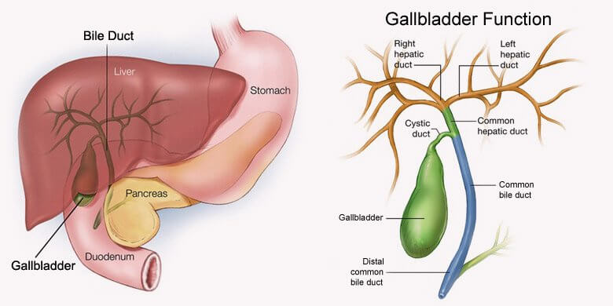
GALLBLADDER

Slide 6
LVER FUNCTIONS 1- Synthesized the coagulant factors 2- Synthesized gastrin hormone 3- Production bile. 4- Store vits., fat, glycogen, zinc, copper 5- Protein metabolism 6- Carbohydrate metabolism 7- Synthesized Cholesterol 8- Produce important anticoagulants 9- It contributes the largest proportion of reticuloendothelial functions

Slide 7
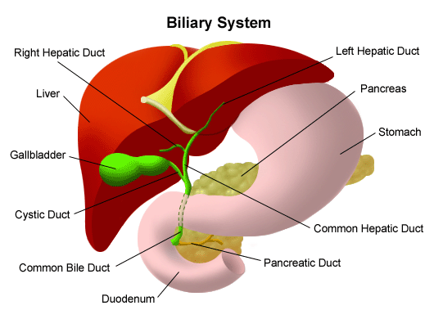
BILE Composed of : bile salts( cholesterol +cholycystokinin ) bilirubin cholesterol phospholipids water bicarbonates

Slide 8
Tolerate of acute removal of total liver may reach to 65%. 28% of dogs with 80% of total liver survived at least 7 days. Liver regeneration begins hours after removal and peaks within 3 days. Near complete compensatory reach by 6 days. It may take up by 6-10 wks.

Slide 9
Traumatic biliary tract rupture: Causes: 1- blunt abdominal trauma. 2- Penetrating wound. 3- Iatrogenic. Leakage of bile ay occur result in bile peritonitis.

Slide 10
Extra hepatic obstruction : Causes : Pancreatitis , neoplasia , gallbladder mucocele , cholangitis and cholelithiasis

Slide 11
Pathological signs: 1- dilatation of common bile duct. 2-increase in serum bilirubin within24-48 hrs. 3- hypotension 4- acute renal failure. 5- gastrointestinal hemorrhage. 6- delayed healing

Slide 12
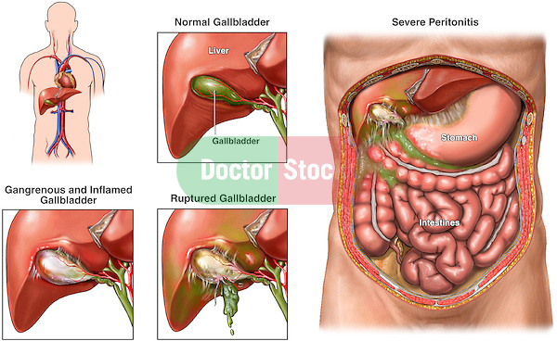
Bile peritonitis : Causes : 1- trauma 2- rupture of gallbladder 3- lesion of upper gastrointestinal

Slide 13
Preoperative considerations for hepatic surgery: coagulant factors , fibrinogen , vit. K ,anticoagulant substances.

Slide 14
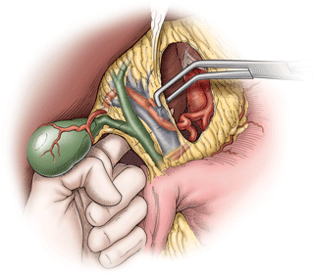
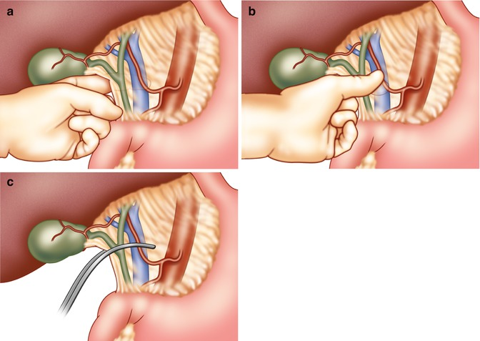
Extensive hemorrhage: vascular occlusion technique Pringle maneuver

Slide 15
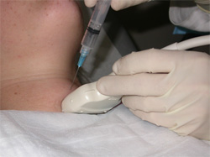
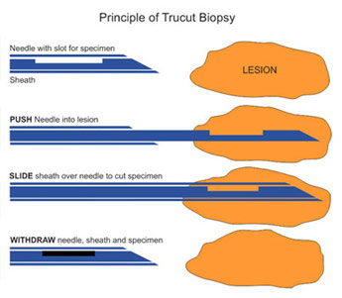
Liver biopsy: 1- Fine needle aspiration 2- Tru-cut

Slide 16
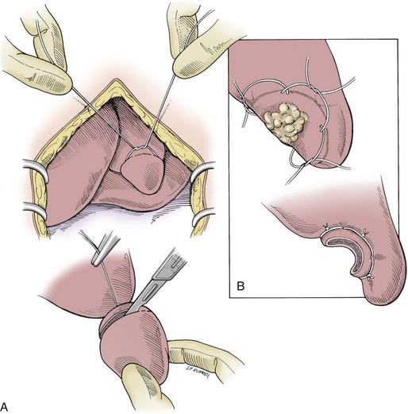
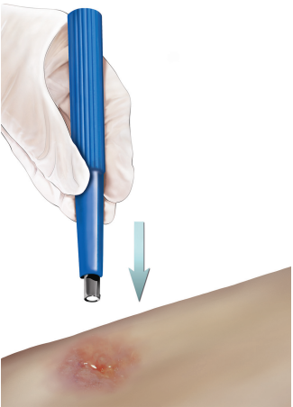
3- Suture fracture. 4- biopsy punch

